Slide 1
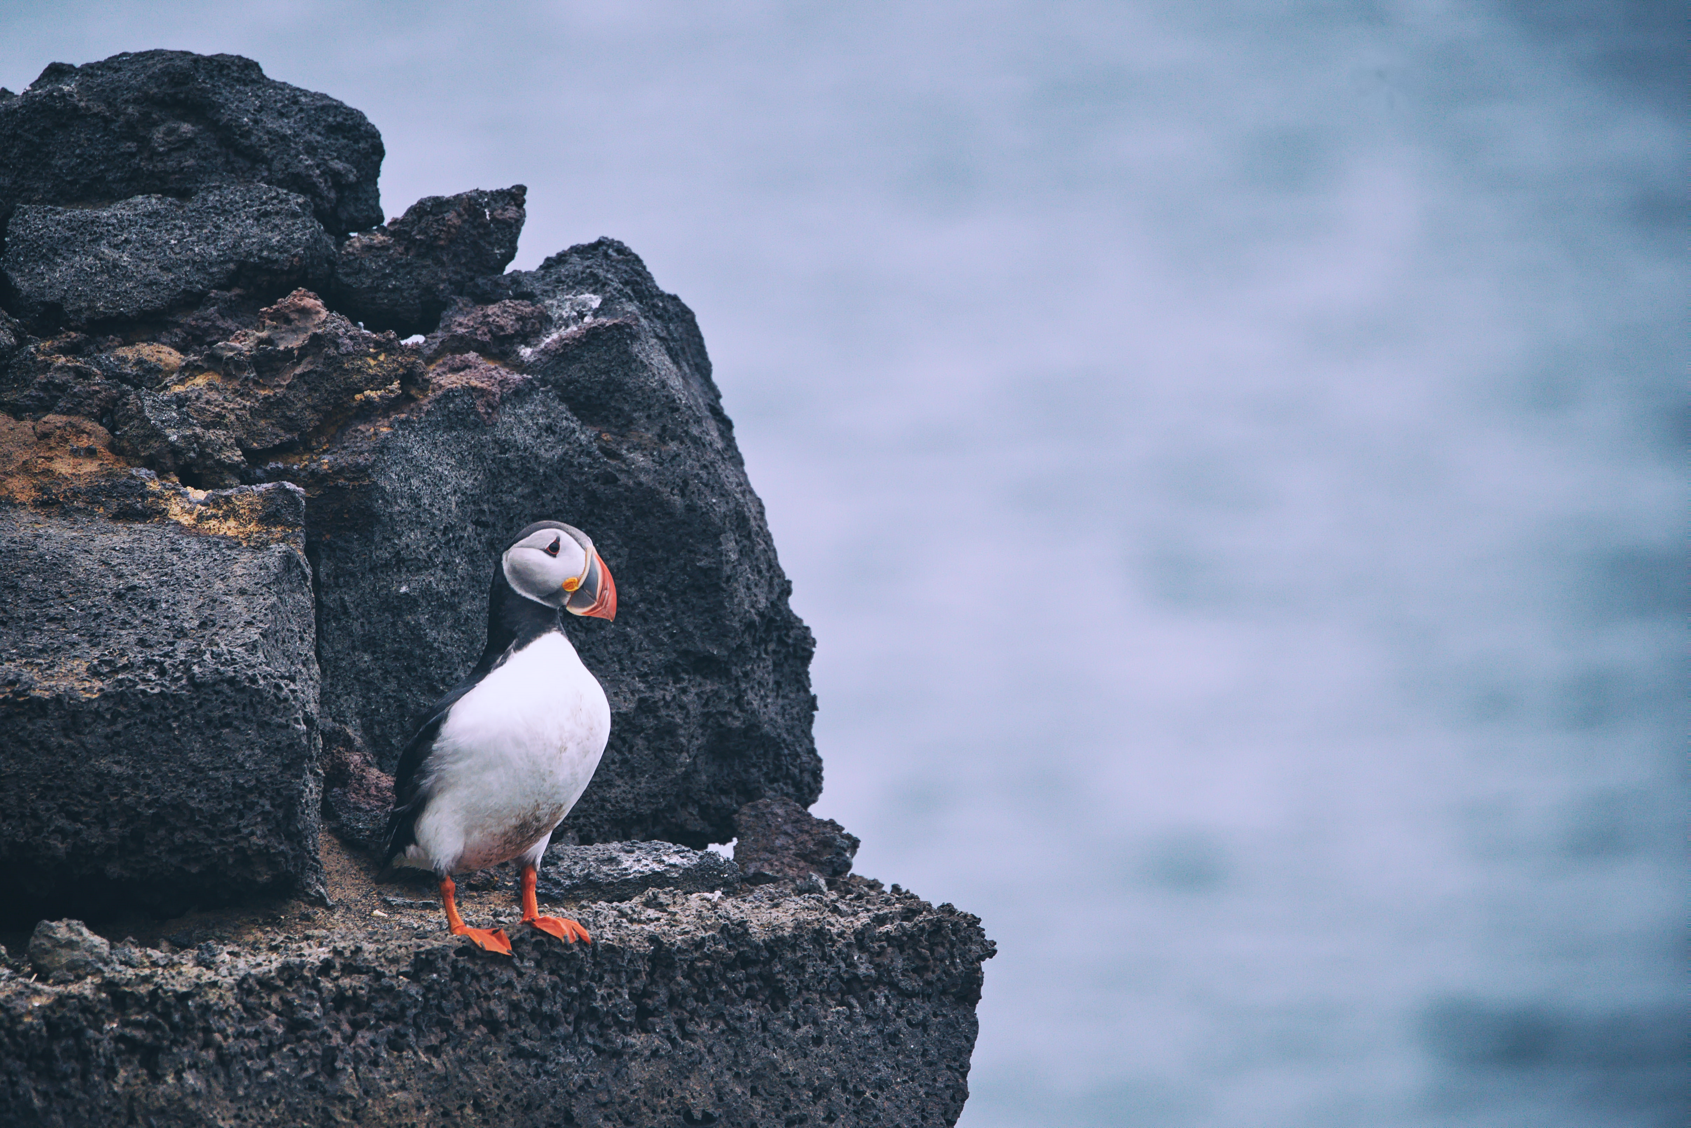
All text in arial
BIRDBOX
Team 25
Anthony Hauger
Cora Schneck
Rachel Pabelico
William Harris
Joey Christee
Scott Young

Slide 2
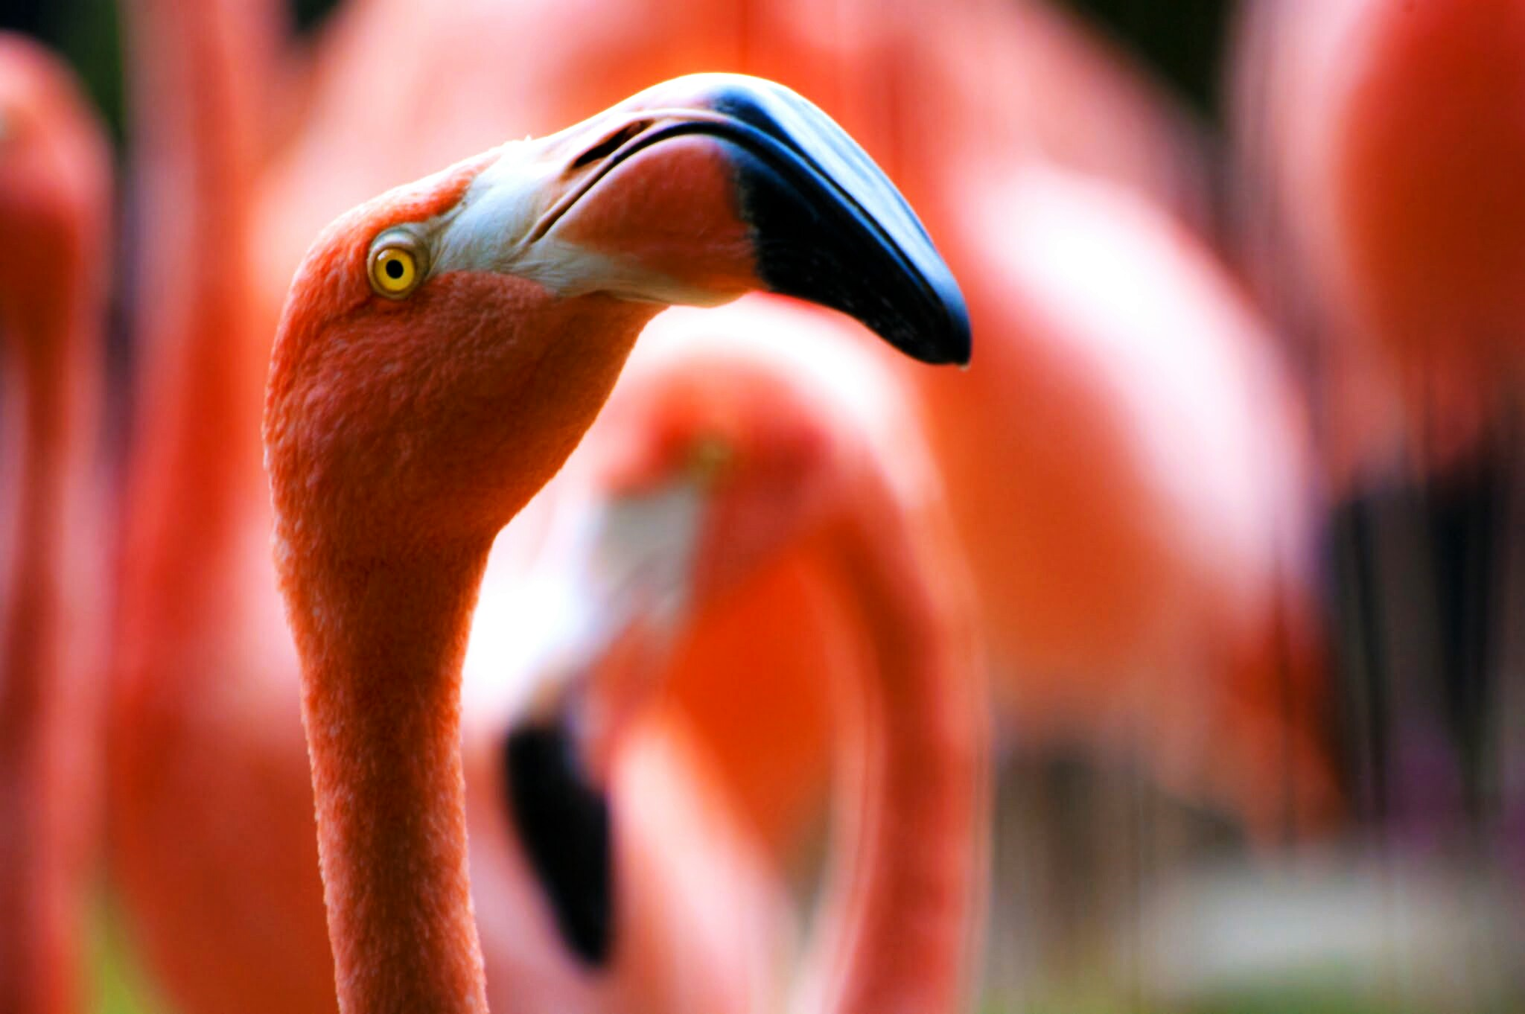

WHAT IS BIRDBOX?
Problem and Solution

Slide 3
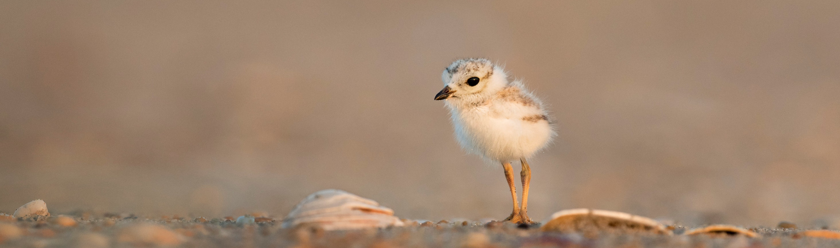

“
”
OUR VISION
To provide competitive user-centered access to avian knowledge
MARKET
$
Students
Scientists
Explorers
Notes:
Anthony

Slide 4
Product Demo
Notes:
Rachel

Slide 5
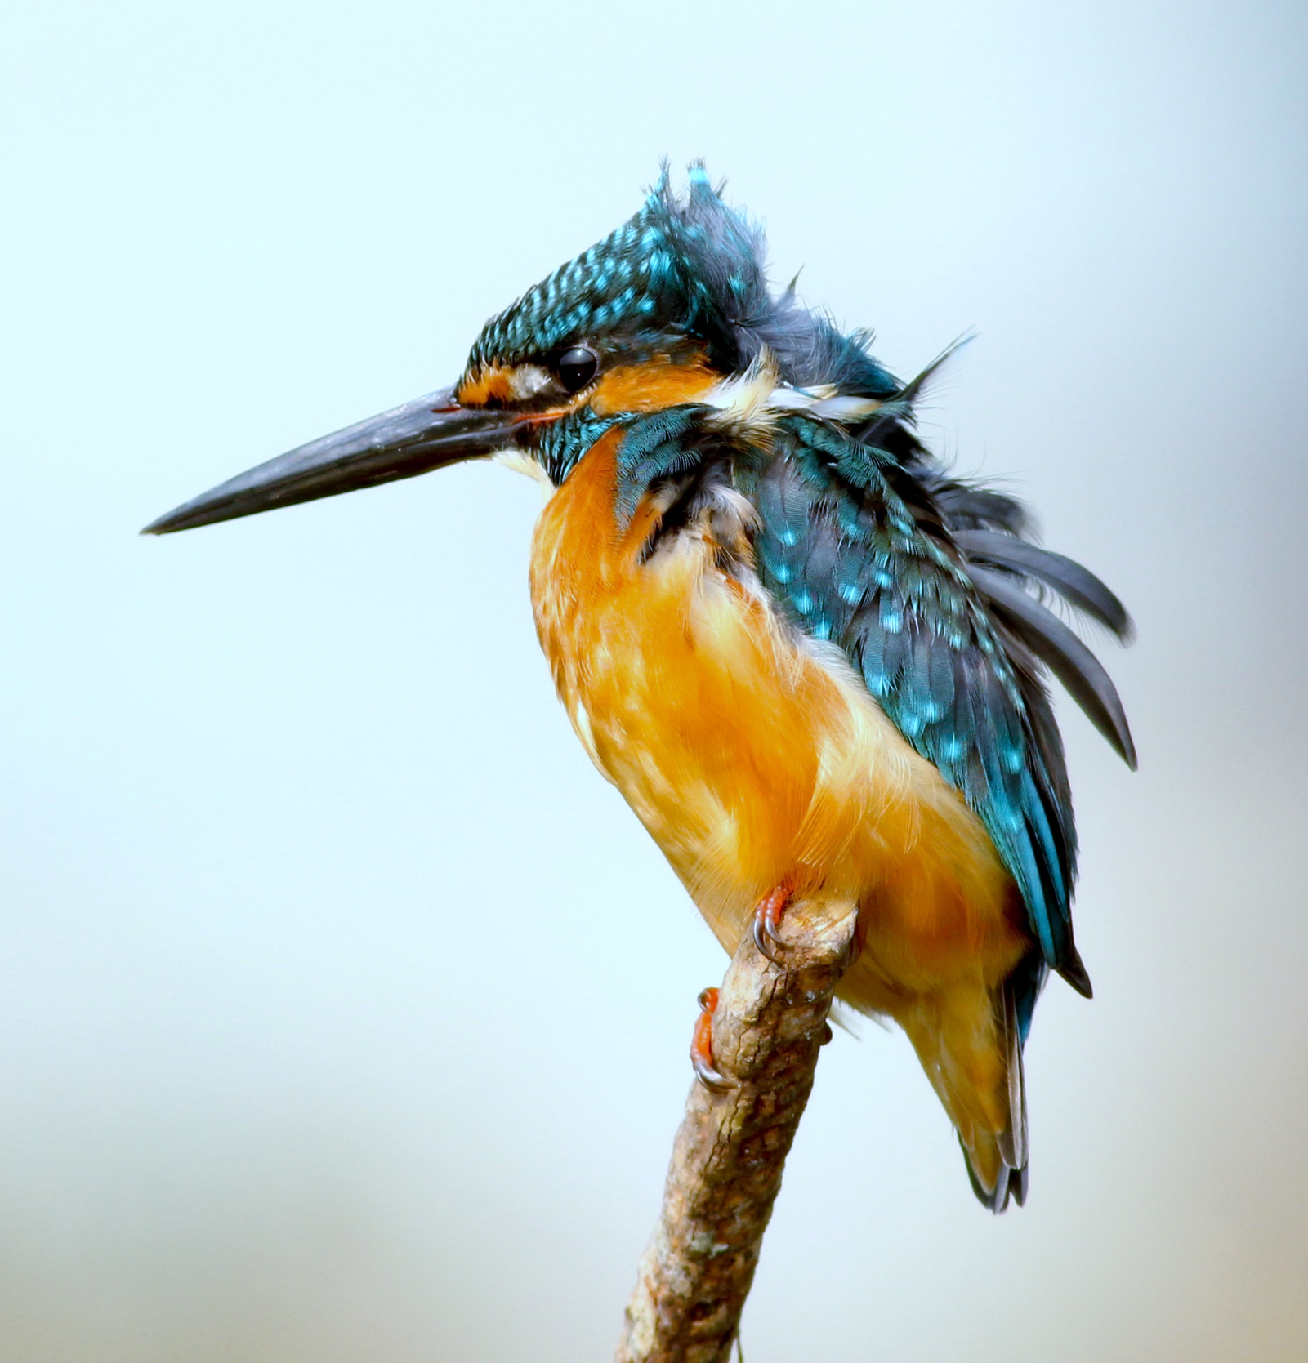
Technical Details
September
Github
HTML Webpage
Populate MySQL
CSS Implementation
PHP
Bootstrap
Automate MySQL
Apache HTTP Server
December
Digital Ocean
Notes:
Cora

Slide 6
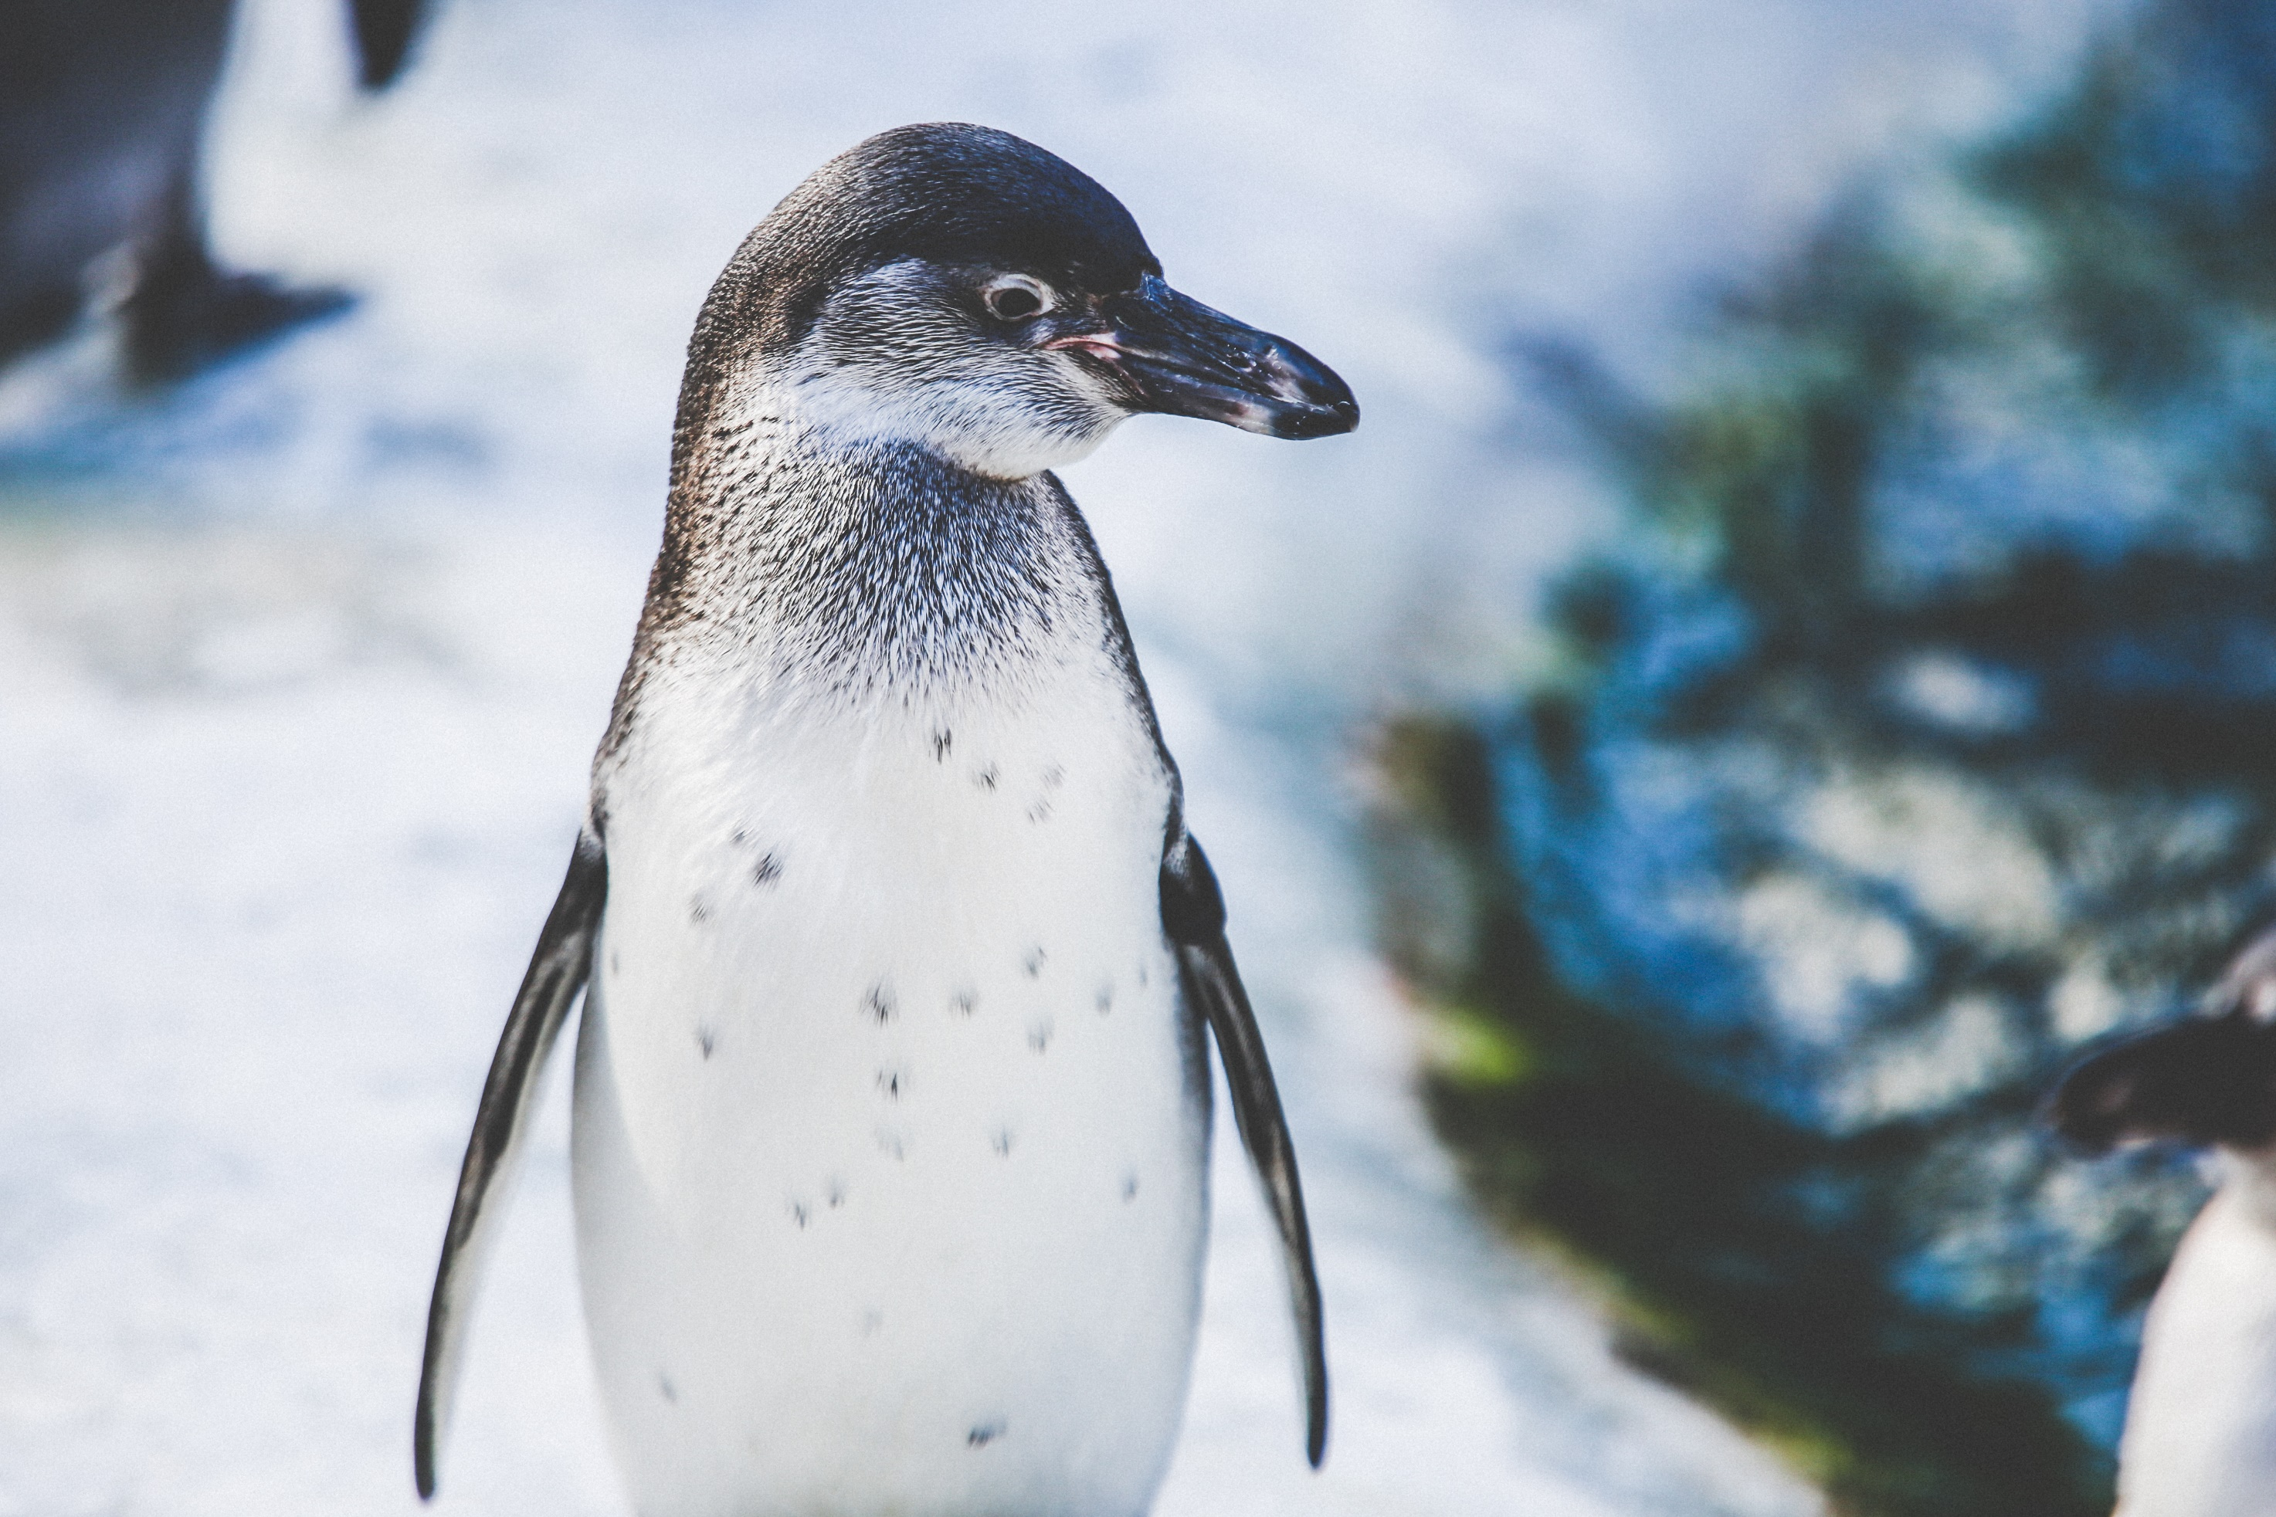
Management and Development
COMMUNICATION
Slack
Google Docs
Trello
DESIGN
Photoshop
Assembly
Notes:
Will

Slide 7
